Slide 1
How to Get Money!
By: Finance Board
Notes:
1-4 AJAI
5-7 MO
8-9 AJAI
10-13 MO
14-19 AJAI
20-23 MO

Slide 2
WHO ARE WE???
We are the Finance Board (F-Board)!
We are a board of 7 members.
Aliza Kahn, Teresa Fong, Xiaoyue Sun, Bronia Goldman, Mohamed Ali (F-board chair), Andre Bourne, and the Treasurer
We allocate funds for secured and chartered clubs
We are NOT the Treasury!
The Treasury dispenses the funds
Each club is assigned their own Student Union Assistant Treasurer

Slide 3
AGENDA
Making Requests and Expectations
Marathon Meetings Sign-Up
Funding Policy
Questions?

Slide 4
MAKING REQUESTS & EXPECTATIONS
Marathon can become busy and stressful for everybody. Just Relax!
Please arrive 15 minutes early and be prepared to stay late
Expect questions regarding the necessity of requests

Slide 5
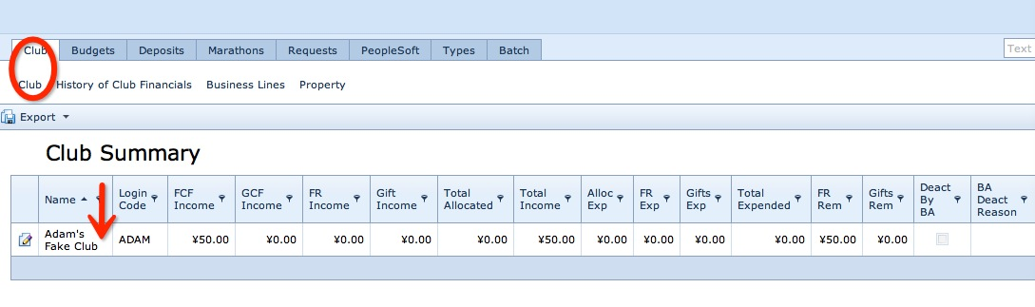
SIGNING UP FOR MARATHON
Go to brandeisweb.com -sign in using your username and password (if unknown, email clubfinance@brandeis.edu)
Search for your club in the list
Select your club

Slide 6
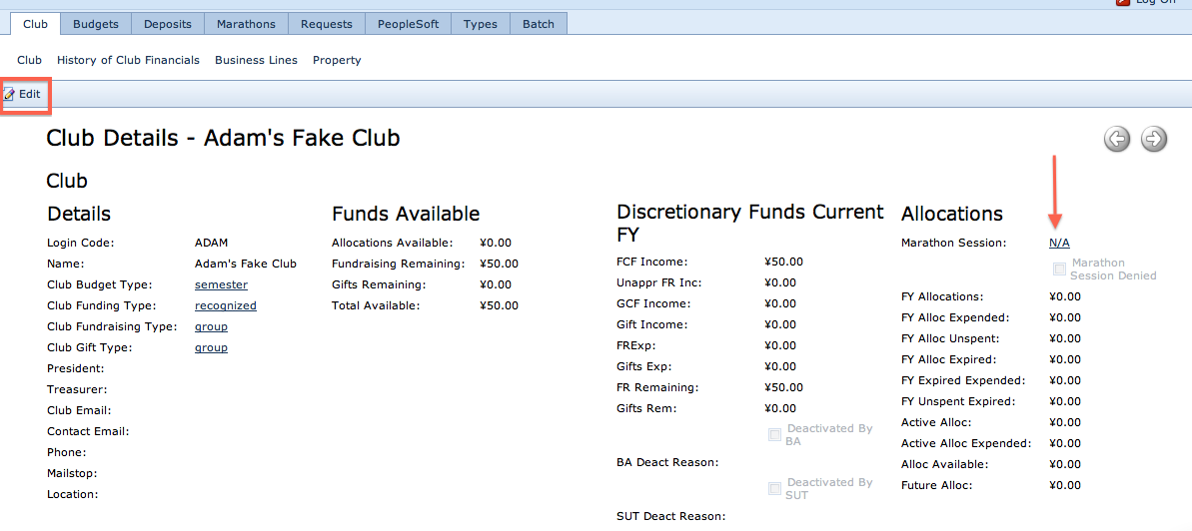
ALMOST THERE…
Go to the tab, Club and the subtab, Club. Click “Edit.” Under allocations, go to marathon session and pick the time block you would want to sign up. Also, be sure to fill out your club president, treasurer, and contact information. We will not meet with you unless this is filled out. ☺☺☺☺ Click Save and Close.

Slide 7
FUNDING POLICY
Defines what CAN and CANNOT be funded
Please be aware that Treasurers will NOT approve requests made outside of the Policy

Slide 8
Overview
As stated in the Constitution and the By-Laws of the Student Union, only secured and chartered clubs are eligible to request and receive funds
The Finance Board receives funding from the Student Activity Fee (SAF)
The SAF is set at 1% of the Brandeis University tuition.
For the 2013-2014 academic year, students contribute $240.00/semester or $480/year.

Slide 9
Policy to Note
Cost Estimates
For certain events clubs must supply cost estimates from:
Public Safety (Ed Callahan)
Conference and Events Services (Kimberly Callahan)
Escort Services (Rupert Thomas Jr)
Jump Start Meetings
Monday @ 3:00 PM in SCC 315
You can either hand-in estimate during your clubs marathon date or e-mail it to the clubfinance@brandeis.edu

Slide 10
Marathons Only Items
Except in extenuating circumstances, the following items will ONLY be funded during Early and Regular Marathon, not during Emergency Request (ER) meetings:
Theater rights
Publishing/printing costs – at least two bids from different companies
Individual contractors and hire (honorariums, speakers, etc.)
Must be competitively priced
Honorariums & Speakers Only:
Average low price is $450 (25 percent). The average high is $1050(75 percent). This means that 75% of all speakers approved cost less than $1050.
Coaches and Instructors
Must be competitively priced and must also cater to enough of the student body to allow for such an expense
All costs must be described prior to the lessons, and should be listed on a per lesson basis
The Finance Board calculates the total semester cost for lessons by multiplying the cost per lesson by the number of lessons we will fund (EX: $100 per lesson x 10 lessons = $1,000)

Slide 11
Marathon Only Items Continued
Transportation
Car:
A maximum subsidy of $0.20 per mile per vehicle may be granted on trips based on timing and location of trip
Parking costs must be researched and then requested prior to a trip (Competitively priced)
Clubs must fill their cars to full capacity
Zipcar:
There is a $25 annual fee –which we will NOT cover. The Board will however consider costs associated with club use of the car. ($8.5/hour or $69/day)
BranVan Rental:
Fill out Escort Safety Services Rental Request Form (union.brandeis.com/treasury)
Clubs must email F-Board Chair or hand in a cost estimate signed, and dated, from Escort Services Event Manager, Rupert Thomas Jr., if clubs expect to rent a BranVan.

Slide 12
Marathon Only Items Continued
Transportation (cont.)
Any other transportation:
In all cases, clubs must research the cheapest cost available and bring proof of research to the Finance Board
All other forms of transportation (train, plane, subway, etc.) are funded at the full discretion of the F-Board
Lodging
Speak with Conference and Events Services to use the Faculty Lodge
In all cases, clubs must research the cheapest cost per person (total cost divided by room occupancy) available and bring proof of research
Clubs are expected to fill lodging spaces to full capacity
Lodgings will only be funded, if it is necessary for a club to fulfill its purpose.

Slide 13
Discretionary Items
Retreats/Training (when legally required for clubs operations):
All training must be held on campus and during the academic year. It must be open for any interested students to attend. However, the instructor may set aside time to work exclusively with club leaders in addition to the public session.
Retreats are defined as off-campus, overnight trips that are intended to promote team bonding and understanding of the purpose of the club
The Finance Board will not fund retreats that are reserved for specific individuals (ex: e-board) within the club
Office Supplies (Publicity/Advertising)
The Finance Board strongly recommends that all clubs take advantage of the resources available in the Club Resource Center (CRC), commonly known as the Romper Room, and in the Student Union office
For questions about office supplies or the CRC or to get access, please contact the Student Union Secretary through secretary@brandeis.edu

Slide 14
Discretionary Items Continued
Admission Fee
Clubs CANNOT require that Brandeis undergraduate students pay admission into any Finance Board-funded events or for any Finance Board funded item without prior Finance Board approval
Approval must be granted at the Marathon meeting. Failure to comply will result in sanctions by the Finance Board.
Clubs may ask for suggested donations, but no undergraduate students should be forced to pay. Non-Brandeis personnel may be charged without approval of the Finance Board for any amount
Clothing
Clothes must be purchased from the "Custom Clothing Club" or a cheaper source
T-Shirts will ONLY be considered and MUST be distributed to the general Brandeis population
Designs are welcome, but remember the average designed shirt cost less than $8 per shirt
Staff shirts may be considered under the discretion of the Finance Board, if imperative to the purpose of the club. AND are property of the club not individuals

Slide 15
Discretionary Items Continued
Food
The Finance Board will consider requests of food only when it is:
Relevant to the purpose of a club
Integral to the goal and structure of an event
Must be a reasonable expenditure (avg. snacks $3/person & meals $8/person)
Must be open and advertised to all Brandeis students
The relevancy must be conveyed at the Marathon meeting
We will NOT fund food for general meetings.
Other Categories not Mentioned
The Finance Board will allocate at its own discretion for other categories
The custodial fee has increased to $250 (from last year’s $175). Be mindful of this when picking a location.
Places that MAY not require a custodial fee - SCC, Residence Hall Lounges, Intercultural Center

Slide 16
Everyone Still With US???

Slide 17
Restricted Items
Exclusive Events
All events must be open to the whole Brandeis community
Retroactive requests:
A retroactive request is a request for reimbursement of money spent on an expense by a club before receiving the Finance Board approval (i.e. you spent money over the summer for a club and you want a reimbursement)
Personal properties:
Personal properties are expenses for items that will not be kept by the club but rather distributed to individuals.
Fundraising costs
The Finance Board does NOT provide funding to allow for clubs to fundraise

Slide 18
Restricted Items Continued
The Undergraduate Theater Collective (UTC) Fee
Prohibitive Costs
Although certain planned events may be legitimate, the costs associated with the event may be unreasonably high.
The Finance Board reserves the right to refuse funding for, or subsidize costs of events that are an irresponsible use of student money
Political Campaigning
Campaigning for a specific political party or member of a party for any public office is not allowed due to Brandeis’ non-profit status.
Campaigning for a specific law, however, is permitted
Chum’s Fee
The Finance Board does not allocate for the Chum’s fee.

Slide 19
Recommendations for Requests
Be specific and detailed about requests. Bring competitive pricing from at least 2 vendors.
Avoid requesting common items that are owned by students (like tights, bobby pins, Hanes T-shirts)
Please keep in mind that each student contributes $240.00 to the SAF, so avoid irresponsible and extremely expensive requests
Keep food costs reasonable and remember Custodian Fees may need to be paid
If multiple clubs are co-sponsoring an event, only one club should request funding for it
This should be noted to the Finance Board during Marathon
For off-campus events with an admission fee, the Finance Board favors subsidizing the cost as opposed to 100% allocation. This allows more students to attend than could have otherwise

Slide 20
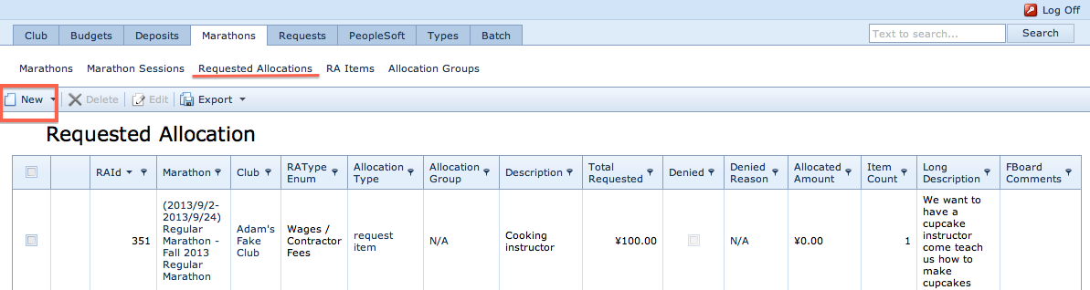
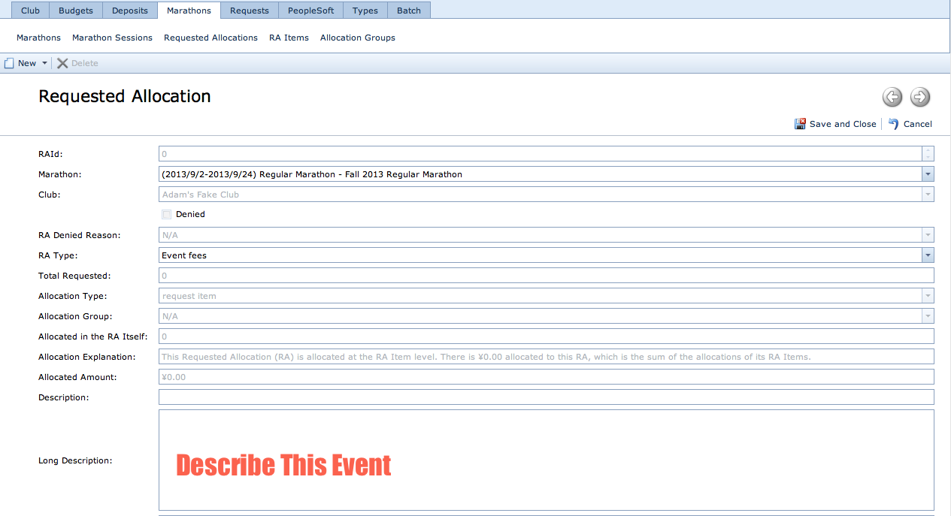
How to Request Funding
Marathons, Requested Allocations, New
Put in the correct marathon date
RA type
Description - name of event
Long Description - describe this event
Save and close

Slide 21
What Type of Request is it?
Event Fees-If you have a CES invoice
Example: Custodial, police, food from SODEXO, noise permits…
Wages/Contractor-If you have someone providing a type of labor service
Example: Speakers, bands, DJs, instructors, coaches
Materials/Supplies-Stuff
Example: food (not from Sodexo), plates, crayons, books, cooking materials… basically any physical stuff
Other-
Travel, league fees, tickets, printing/publication fees

Slide 22
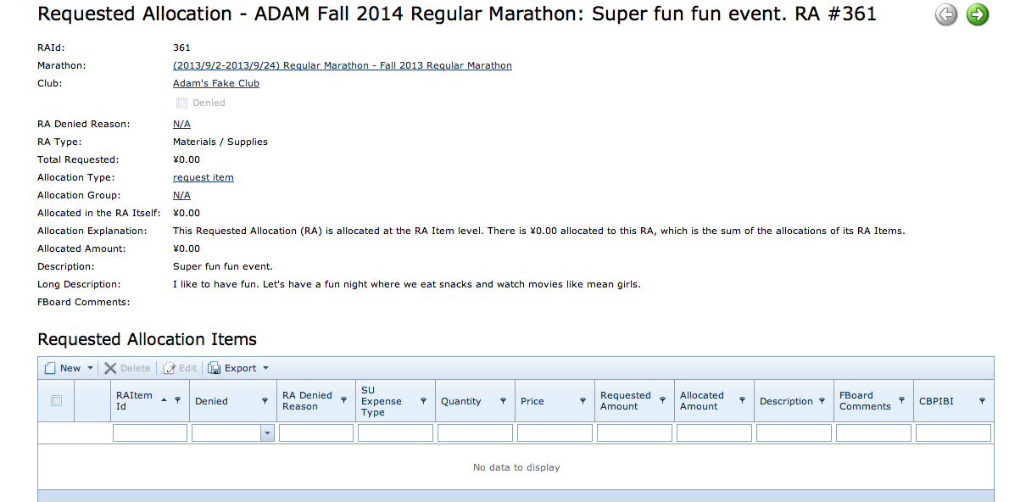
How to Request Funding (continued)
To request items within the materials/supplies parts of event, click New. If not within materials/supplies, a new Requested allocation should be created

Slide 23
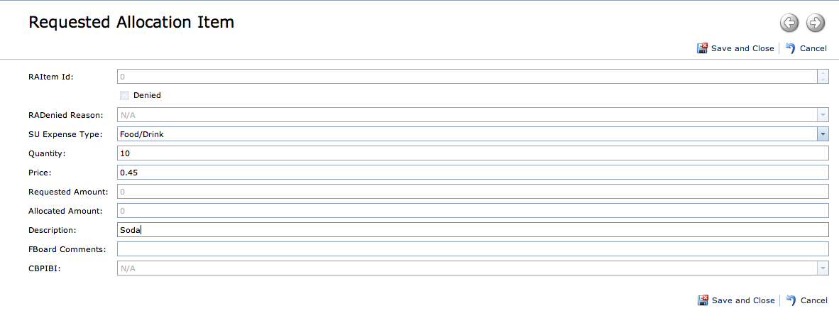
How to Request Funding (continued)
Under SU expense type, decide what it is
Quantity-how many?
Price- per item
Description- what is it?
Save and Close!!!!!
You can add as many Request Items as you want if they are under the same type of request.

Slide 24
Financial Misconduct
Misusing money allocated by the Finance Board is defined as using SAF money for any expenditure not approved by the Finance Board
This includes buying supplies for events that were not specified at the Marathon, buying items that were denied, or overspending
This violation of trust prevents the Finance Board from providing funds to these violating clubs in the future
In the event of non-compliance with the rules and regulations the Finance Board and the Treasury will withhold all reimbursements and future funding until an agreement can be made with the Treasurer, the Finance Board, and the violating parties

Slide 25
WHO TO CONTACT?
If you have any questions/concerns about allocations please contact:
clubfinance@brandeis.edu

Slide 26
ANY QUESTIONS
???

